Slide 1

Get to know ICANN
Internet Service Provider and
Connectivity Provider Constituency (ISPCP)
www.ispcp.info

Slide 2

ISPCP Basics
Became a constituency within the GNSO in 1999
Global membership includes:
  ISPs or connectivity providers
  that operate an Internet backbone network
  ISPs or connectivity providers that provide access to either Internet users or Internet content providers
  Related ISP Associations
Over 60 Members – see ispcp.info/members
Member of the Commercial Stakeholders Group (CSG)
in the Non-Contracted Parties House (NCPH) of
ICANN’s Generic Names Supporting Organization (GNSO)

Slide 3

ISPCP Mission
Ensure that the views of its members contribute toward fulfilling the aims and goals of ICANN and to the benefit of the ICANN community.
Ensure that policy development within ICANN guarantees and enhances the operational stability and security of the Internet.
Committed to the effectiveness of the ICANN Multistakeholder Model.

Slide 4
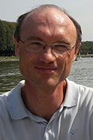
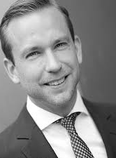
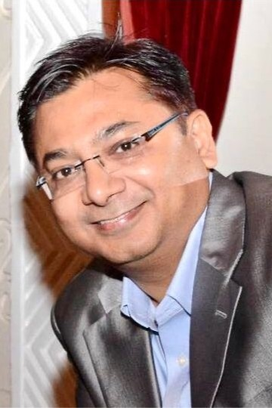
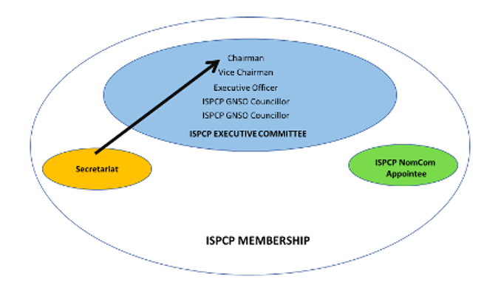
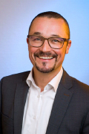
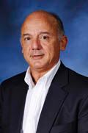
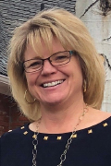
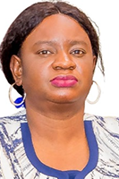
ISPCP Structure
Philippe Fouquart, Chair
Lars Steffen, Vice Chair
Santanu Acharya, Exec Officer
Susan Mohr, GNSO Councilor
Osvaldo Novoa, GNSO Councilor
Fiona Asonga, NomCom Delegate
Membership Coordinator
Credentials Committee

Slide 5
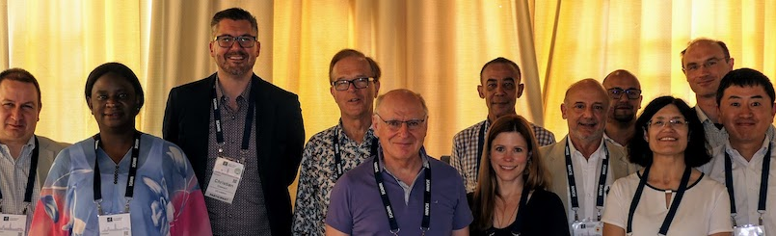
How do Members Participate in the ISPCP?
Follow the mailing list
Join monthly community meetings
Participate in ICANN Policy Development (Council, Working Groups, CCWGs, etc.)
Represent the ISPCP in working groups and other ICANN initiatives
Contribute to Constituency Statements and Drafts and help members support the MSM beyond ICANN

Slide 6

ISPCP Policy Development
The ISPCP guides policy development on issues related to the operational stability of management of the DNS root zone.
ISPCP members help shape policies that affect ISPs and connectivity providers or cause disruptions in how ISP customers interact with the Internet.
Policy Issues are decided by consensus whenever possible.

Slide 7

ISPCP Policy Development Process
Consultation and Approval
Members have 7 working days for comment
Solidarity
Final position represented by all Members when representing the ISPCP
Drafting Team Leader Identified
Develops draft position
Shepherds draft for consultation and approval
If no comment, deemed approved
Final position determined by consensus

Slide 8

ISPCP 2026 Policy Statements
Comment on the DNS Abuse Mitigation PDP 1 Initial Report
September 2026
Comment Input - TSG on gTLD Integrations with Alternative Naming Systems
September 2026
Response to Public Comment - Review of Reviews Draft Report
June 2026
Input on Review of Reviews Cross Community Group (CCG) Refined Proposal Outline
June 2026
Letter to ICANN Board - Structural Review
April 2026
Public Comment on Guidelines for Advancing Universal Acceptance (UA) Adoption
April 2026
ISPCP Input to RoR - Structural Review
March 2026
ISPCP Input for the 2026 ICANN Nominating Committee Cycle
March 2026
ISPCP Early Community Input GNSO DNS Abuse Mitigation PDP1
March 2026
Link to ISPCP Policy Statements

Slide 9

Policy Issues and other Priorities
Main gTLD policy issues
  new gTLD program / Alternative Naming Systems
  Whois Registration Data Retrieval System (RDRS/SSAD)
  Registration Data Accuracy
  DNS Abuse
Cross community initiatives
  Holistic Review / Review of Reviews
Topics of interest and member support
  Technical issues including Internet Fragmentation, DNS resolvers
  DNS Capacity building webinar series
  Hands-on sessions at ICANN81, ICANN82, ICANN85, ICANN86

Slide 10

Constituency Challenges
Membership Engagement
Global Member Recruitment
ICANN Policy Development – ISP Relevance

Slide 11
ICANN87 ISPCP Sessions
GNSO: ISPCP Membership Work Session (public)
Tuesday, October 20, 2026, 4:30 PM - 5:30 PM GMT+08
Room: Hibiscus (Committee Breakout 3)
GNSO: ISPCP Outreach Session (public)
Wednesday, October 21, 2026, 10:30 AM - 12:00 PM GMT+08
Room: Frangipani (Committee Breakout 4)

Slide 12
Routing Security / MANRS
Speakers
Geoff Huston, Chief Scientist at APNIC
Maarten Aertsen, Senior Internet Technologist, NLnet Labs
Warren Kumari, Director of Internet Standards, Google

Slide 13
Common mistakes in DNS configuration
Speakers
Peter Thomassen, Chief Technology Officer, deSEC
Raffaele Sommese, Assistant Professor, University of Twente
Gautam Akiwate, Software Engineer, Apple

Slide 14

Thank you!

